Slide 1


Adrian Graumnitz
06.03.2025

Slide 2
Outline
Executive Summary
Introduction
Methodology
Results
Conclusion
Appendix

Slide 3
Executive Summary
Data Collection
with the SpaceX API
Web scraping from Wikipedia
Summary: Achieve 87% accuracy in data recovery
Data Wrangling
Prepare the Data for Analysis and Prediction

Slide 4
Executive Summary 2
Analysis through SQL and visualize
Store the Data in a Database
Create visualization for the Data
Build interactive Dashboards
Build Dashboards for better insights
ML Prediction on the data
Train a model to predict future outcomes based on the data

Slide 5
Introduction
The goal is to develop reusable rockets by recovering the first stage.
Compare different types of data, such as launch site and payload, to identify the best conditions for success.
To achieve this goal python as programming language was used

Slide 6

Section 1

Slide 7
Executive Summary
Data collection methodology:
Create two Data Sets through SpacX API and the Web Scraper Beautyful Soup
Perform data wrangling
Determine Training Labels and store them in the Data
Preparing the Data for the ML Model
Perform exploratory data analysis (EDA) using visualization and SQL
Perform EDA using visualizations and SQL queries to uncover trends and insights.
Visualize through Matplotlib and Seaborn to analyze the Data
Methodology

Slide 8
Methodology
Executive Summary
Perform interactive visual analytics using Folium and Plotly Dash
Perform predictive analysis using classification models
Standardize the Data
Use various approaches to identify the best solution, including Grid Search and Support Vector Machine classification, among others.

Slide 9
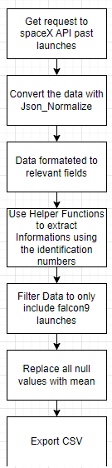
Collect data from the SpaceXAPI
https://github.com/AdrianGraumnitz/IBM-Professional-Certificate/blob/main/_Capstone%20Project/1.%20Collecting%20the%20Data/1.%20spacex-data-collection-api-v2.ipynb
Data Collection – SpaceX API

Slide 10
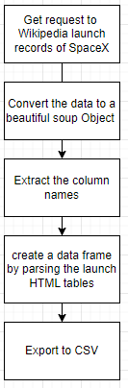
Data Collection - Scraping
To collect historical launch data, I used web scraping techniques to gather information from Wikipedia.
https://github.com/AdrianGraumnitz/IBM-Professional-Certificate/blob/main/_Capstone%20Project/1.%20Collecting%20the%20Data/2.%20webscraping.ipynb

Slide 11
Data Wrangling 1
Through the landing outcomes, a 'class' column was created with labels
1 = landed
0 = not landed
https://github.com/AdrianGraumnitz/IBM-Professional-Certificate/blob/main/_Capstone%20Project/2.%20Data%20Wrangling/spacex-Data%20wrangling-v2.ipynb

Slide 12
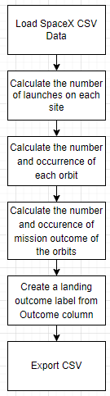
Data Wrangling 2

Slide 13
To predict the success of the Falcon 9 first stage landing, I utilized scatterplots, bar plots, and line charts to explore the relationships between various variables and the landing success.
Scatterplots for numerical variables
Bar plots for categorical data
Line plots for visualizing the success rate trend
https://github.com/AdrianGraumnitz/IBM-Professional-Certificate/blob/main/_Capstone%20Project/3.%20Exploratory%20Analysis%20Using%20SQL/eda-datavisualization-with-Pandas-Matplotlib-v2.ipynb
EDA with Data Visualization

Slide 14
Create a Data Base for the SpaceX Data
Show the unique launch sites
Show first successful landing
Compare Booster Version and payload mass
List the total number of successful and failure mission outcomes
Rank the count landing outcomes
https://github.com/AdrianGraumnitz/IBM-Professional-Certificate/blob/main/_Capstone%20Project/3.%20Exploratory%20Analysis%20Using%20SQL/eda-sql-coursera_sqllite.ipynb
EDA with SQL

Slide 15
I create markers for each launch site, to get a better understanding where the launch sites are (near the coast etc.)
I create circles around the markers to enhance the visualization
To show the approximates to cities, railroads and coastlines we also use markers and define a line between them and approximated launch site
https://github.com/AdrianGraumnitz/IBM-Professional-Certificate/blob/main/_Capstone%20Project/4.%20Interactive%20Dashboards/Interactive%20Visual%20Analytics%20with%20Folium%20lab.ipynb
Build an Interactive Map with Folium

Slide 16
Creating a pie chart to visualize the total success rate by all launching sites and success rate for every launching site
Creating a range slider with a scatterplot to show the relation between the success rate, the payload mass and the booster version
https://github.com/AdrianGraumnitz/IBM-Professional-Certificate/blob/main/_Capstone%20Project/4.%20Interactive%20Dashboards/Interactive%20Dashboard%20with%20Plotly%20Dash.py
Build a Dashboard with Plotly Dash

Slide 17
We create a test and training set and use different concepts to find the best working hyperparameters
In the end the results are almost the same, the true positive results are perfect, but it also have false positive results (3 by every test)
The best test accuracy is 83.33%
https://github.com/AdrianGraumnitz/IBM-Professional-Certificate/blob/main/_Capstone%20Project/5.%20Predicitive%20Analysis/SpaceX-Machine-Learning-Prediction.ipynb
Predictive Analysis (Classification) 1

Slide 18
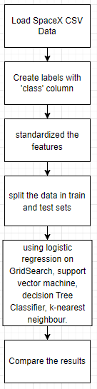
Predictive Analysis (Classification) 2

Slide 19
Results 1
A model was created using SpaceX data to improve the prediction accuracy of the first-stage landing success rate. By analyzing historical data, the model identifies key factors influencing landing outcomes and provides insights that could contribute to higher success rates in future launches.

Slide 20
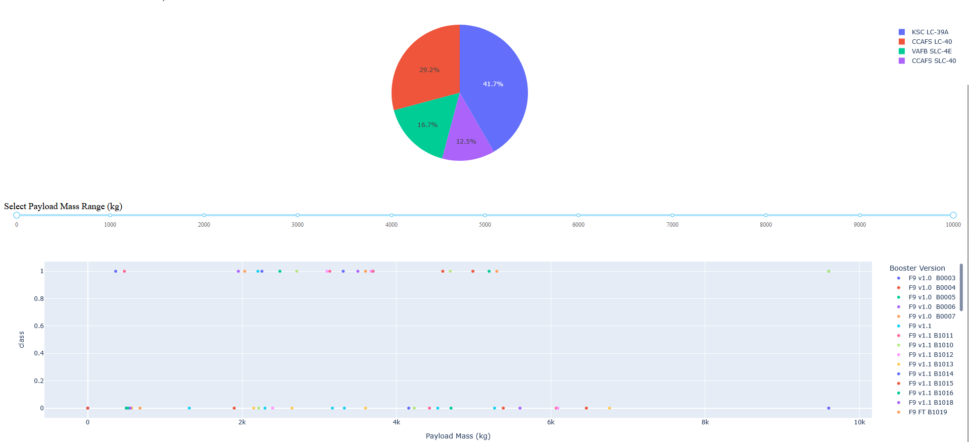
Results 2

Slide 21

Section 2

Slide 22
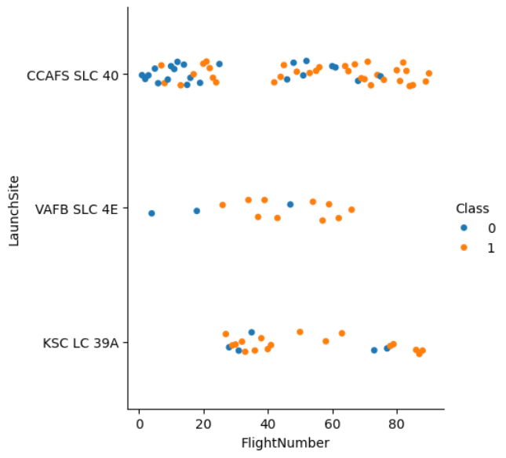
Flight Number vs. Launch Site 1

Slide 23
Flight Number vs. Launch Site 2
On the foil, you can see that by increasing the flight number, more rockets are landing.

Slide 24
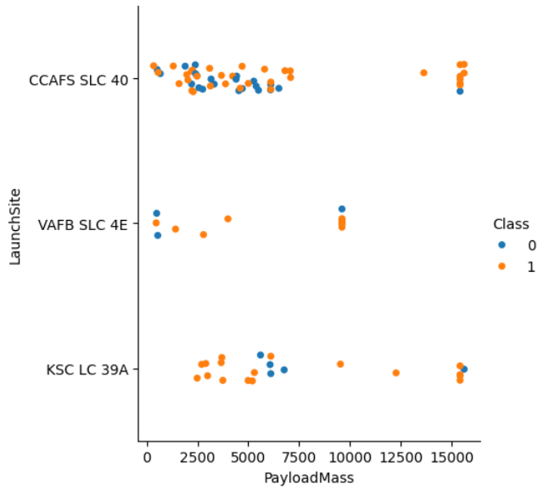
Payload Mass vs. Launch Site 1

Slide 25
Payload Mass vs. Launch Site 2
On the foil, you can see that by increasing the Payload Mass, more rockets are landing.

Slide 26
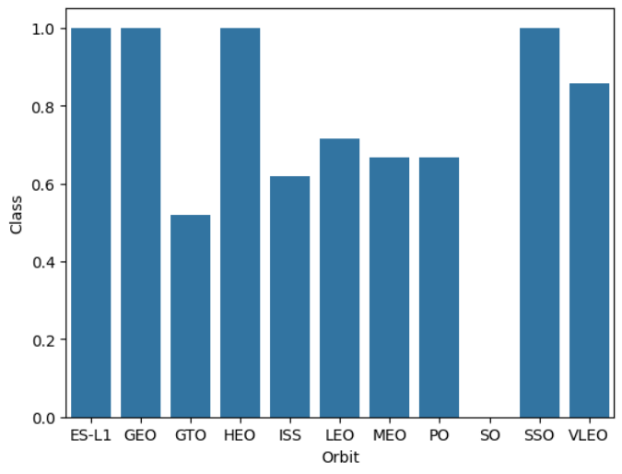
Success rate vs orbit type 1

Slide 27
Success rate vs orbit type 2
On the foil, you can see that the success rate is the highest by the orbit types:
ES-L1
GEO
HEO
SSO

Slide 28
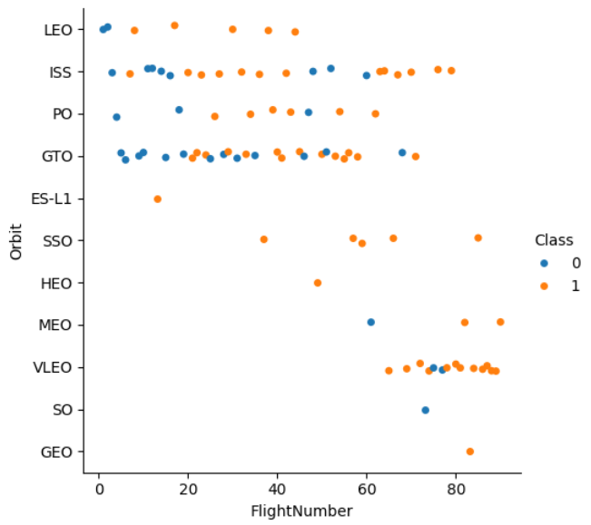
Orbit type vs Flight- number 1

Slide 29
On the foil, you can see that most flights go to:
ISS
GTO
The following orbit stations have a small percentage of failed landings:
LEO
ISS
PO
VLEO
Orbit type vs Flight- number 2

Slide 30
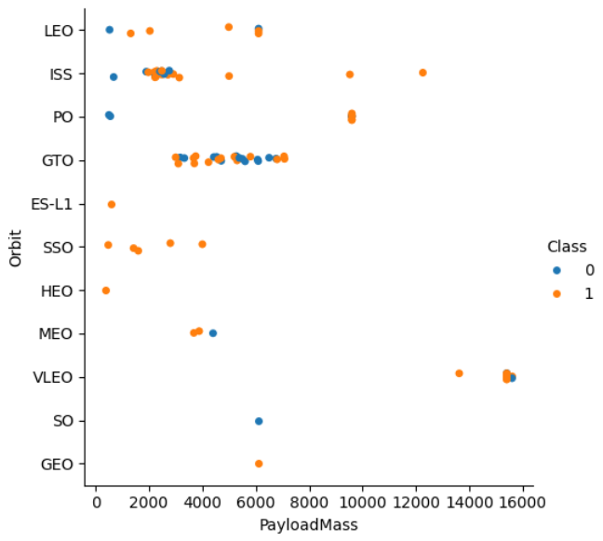
Payload vs orbit type 1

Slide 31
On the foil, you can see that payload mass tends to increase with certain orbits like GTO and GEO, while successful landings (Class 1) are more frequent in lower payload masses across various orbits
Payload vs orbit type 2

Slide 32
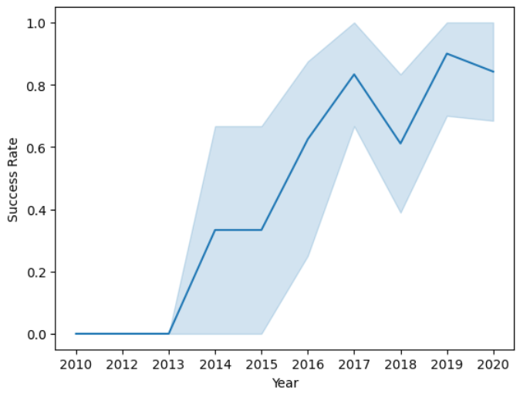
Launch success yearly trend

Slide 33
On the foil, you can see that the success rate increases over the years, with break in 2018 and 2020.
Launch success yearly trend

Slide 34
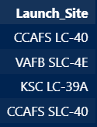
The launch sites are:
Cape Canaveral Space Force Station (CCAFS LC-40 and CCAFS SLC-40)
Vandenberg Space Force Base (VAFB SLC-4E)
Kennedy Space Center (KSC LC-39A)
All Launch Site Names

Slide 35
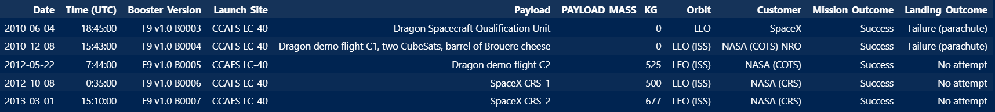
You can see that none of them have information about a positive landing outcome. They were all going to the LEO orbit station.
Launch Site Names Begin with 'CCA'

Slide 36

The total payload mass carried by boosters launched by NASA
Total Payload Mass

Slide 37
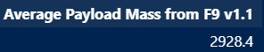
Average payload mass carried by booster version F9 v1.1
Average Payload Mass by F9 v1.1

Slide 38

The date when the first successful landing outcome in ground pad was achieved
First Successful Ground Landing Date

Slide 39
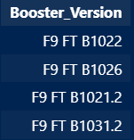
Names of the boosters which have success in drone ship and have payload mass greater than 4000 but less than 6000
Successful Drone Ship Landing with Payload between 4000 and 6000

Slide 40
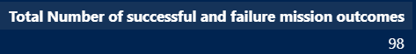
Total Number of Successful and Failure Mission Outcomes

Slide 41
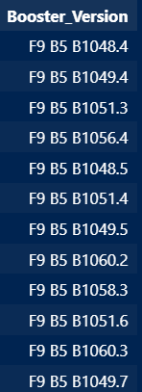
Names of the booster versions which have carried the maximum payload mass
Boosters Carried Maximum Payload

Slide 42
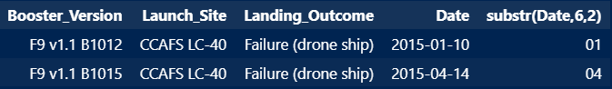
Records which will display the month names, failure landing outcomes in drone ship ,booster versions, launch site for the months in year 2015
2015 Launch Records

Slide 43
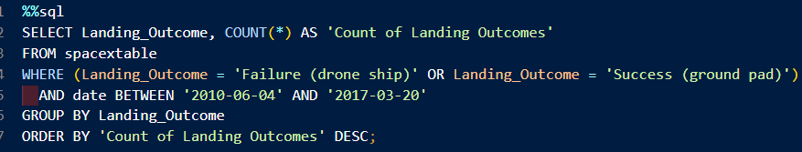
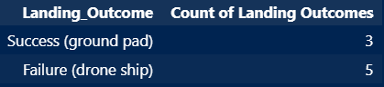
Records which will display the month names, failure landing outcomes in drone ship ,booster versions, launch site for the months in year 2015
Rank Landing Outcomes Between 2010-06-04 and 2017-03-20

Slide 44

Section 3

Slide 45
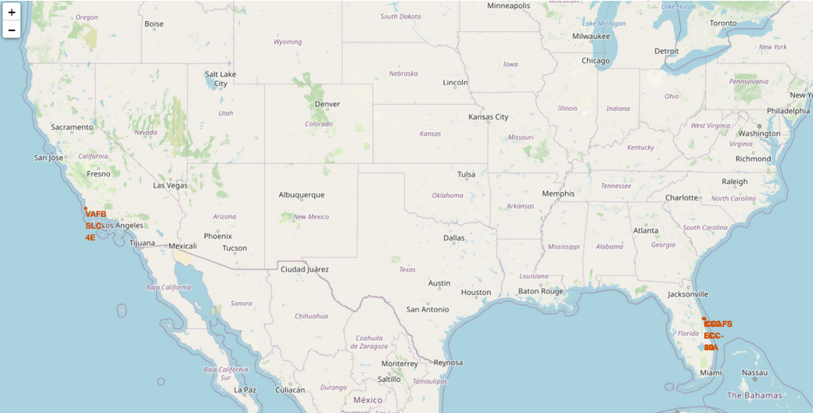
The launch sites are marked in orange, with their names displayed on the map
Launch sites

Slide 46
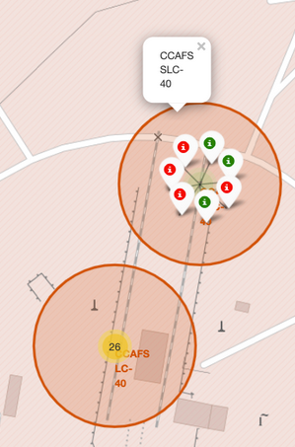
The green launch outcomes indicate that the landing was successful, while the red ones show that it was not
Launch outcomes

Slide 47
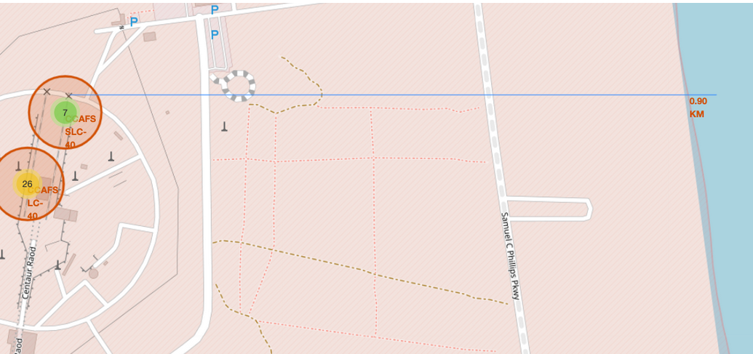
There are 900 meters to the nearest coastline from Cape Canaveral
Distance to coastline

Slide 48

Section 4

Slide 49
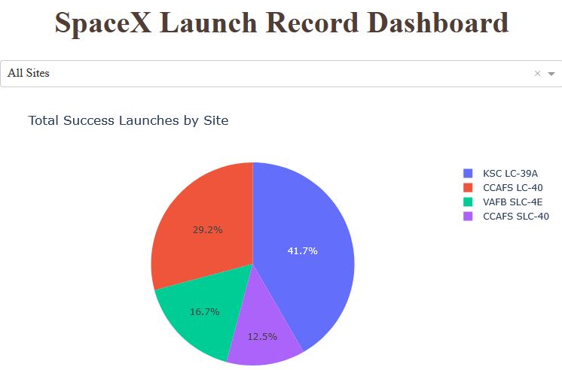
Dashboard pie chart 1
Kennedy Space Center, followed by Cape Canaveral, has the most successful launches

Slide 50
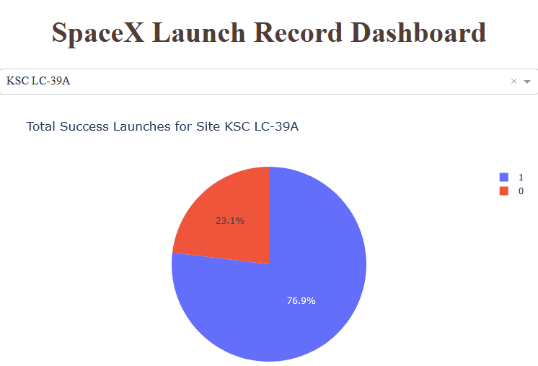
Dashboard pie chart 2
Kennedy Space center has the highest success rate for launches

Slide 51
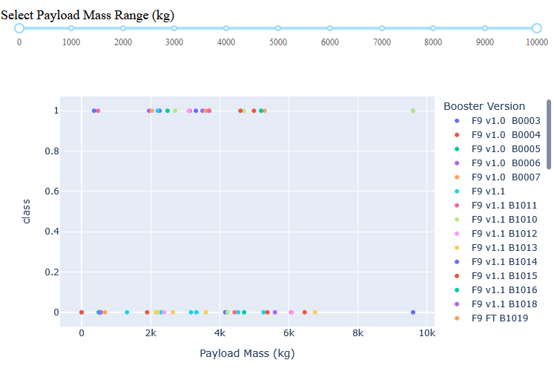
Dashboard range slider, scatter plot
The highest success rate for landing the first stage is between 2000 kg and 6000 kg

Slide 52

Section 5

Slide 53
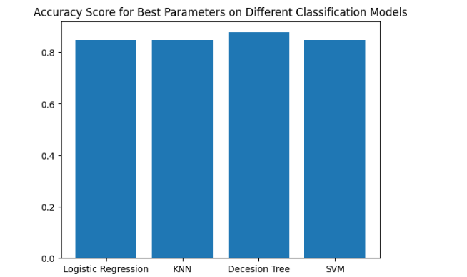
Classification Accuracy
The highest accuracy has the decision Tree with 87.67 %

Slide 54
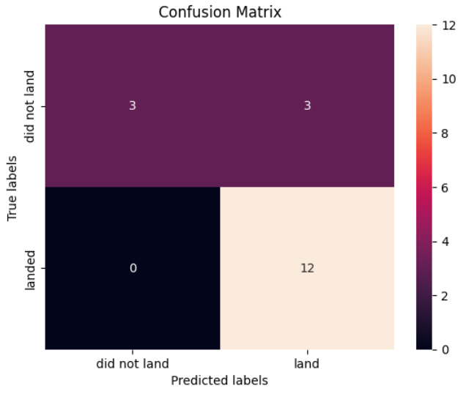
Confusion Matrix
All the model have the same result

Slide 55
I formatted the data, created visualizations to compare different categories, and developed an interactive dashboard to explore the data. Additionally, I built a model that helps us better understand which categories are important and how they relate to each other, ultimately increasing the probability of a successful first-stage landing
Conclusion

Slide 56


